Slide 1

Automated Smart City/Community Cleaning system IoT middleware
Karthika Nair , Changlong Ji
M2 CSN

Slide 2
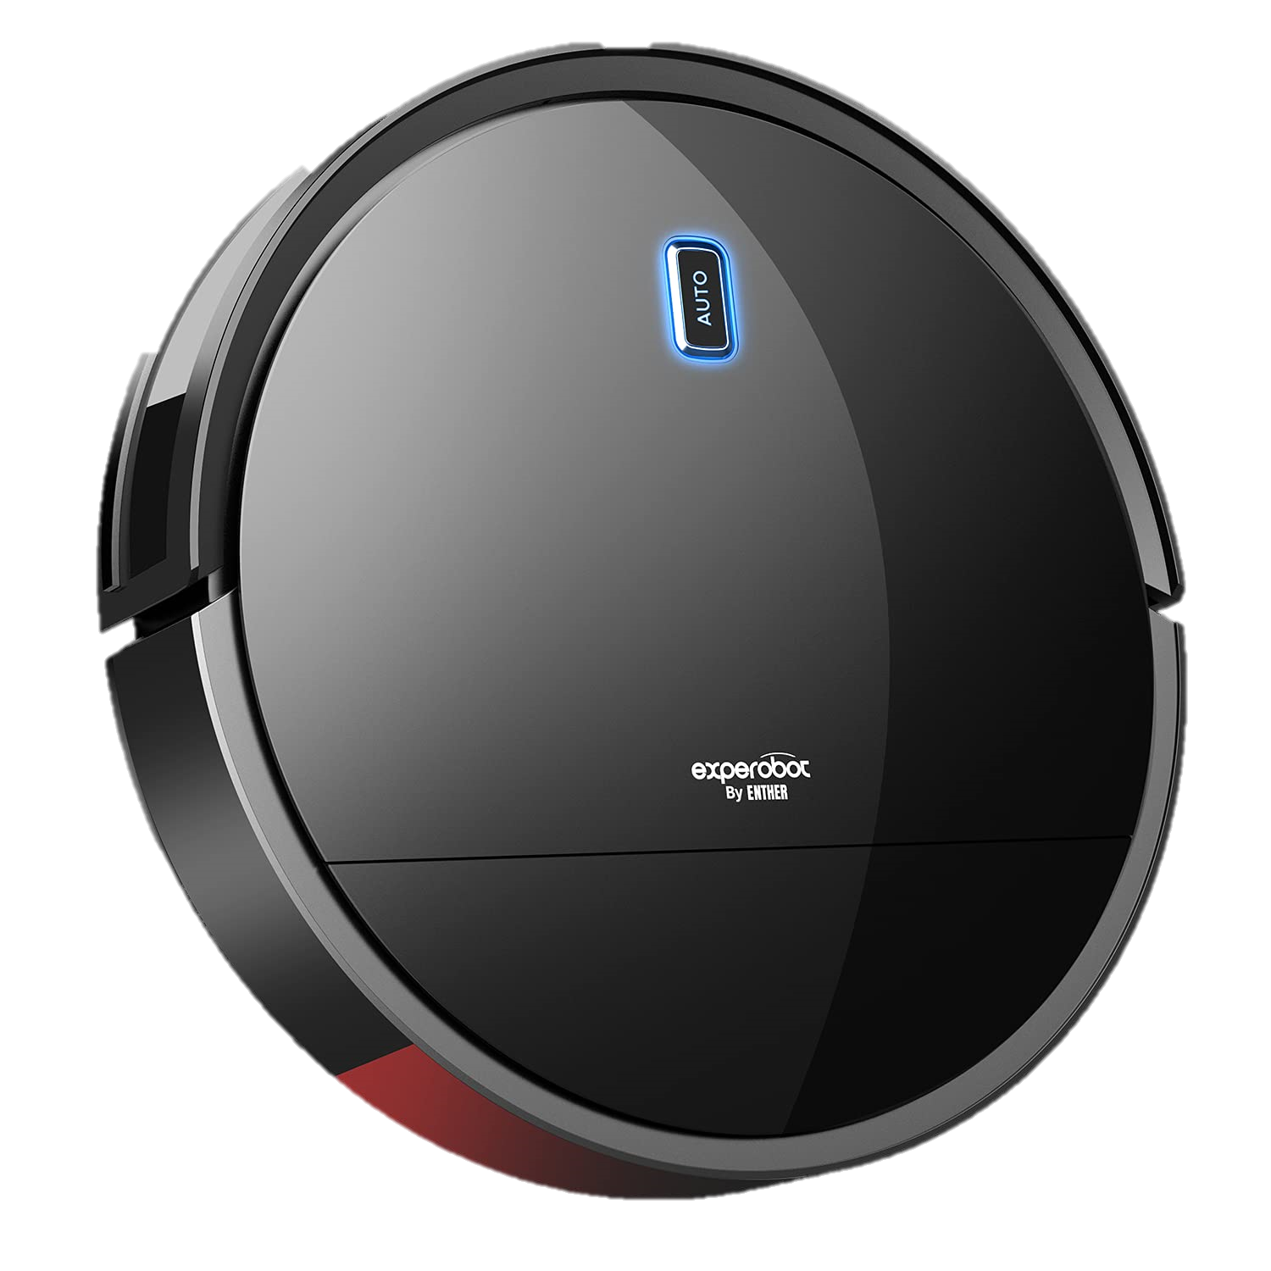
We have heard about robotic vacuums and wireless floor cleaners for homes and offices .
What if we can apply the same principle in cleaning streets in big Cities?

Slide 3
MOTIVATION
Existing Frameworks for smart house, office etc.
Improving quality of life for residents
Reduction of Operational Costs: Automation and optimization of cleaning processes can lead to cost savings in terms of labor, fuel, and equipment maintenance.
There are less existing framework for smart city cleaning.

Slide 4
GOALS
Building an efficient smart city cleaning system with multiple middleware technologies that is:
Having Timely Response
Real-Time Monitoring
Scalable
Cost Efficient
Reduce Environmental Impact

Slide 5
Proposed Project
Our System have several cameras for zones of a city
(Our project uses one camera for one zone for experiment)
Each Camera detects waste using ML Approach and alerts the robots present near the zone.
Each robot calculates its distance to the zone and return its value
The robot with minimum distance goes to location and cleans the waste.

Slide 6
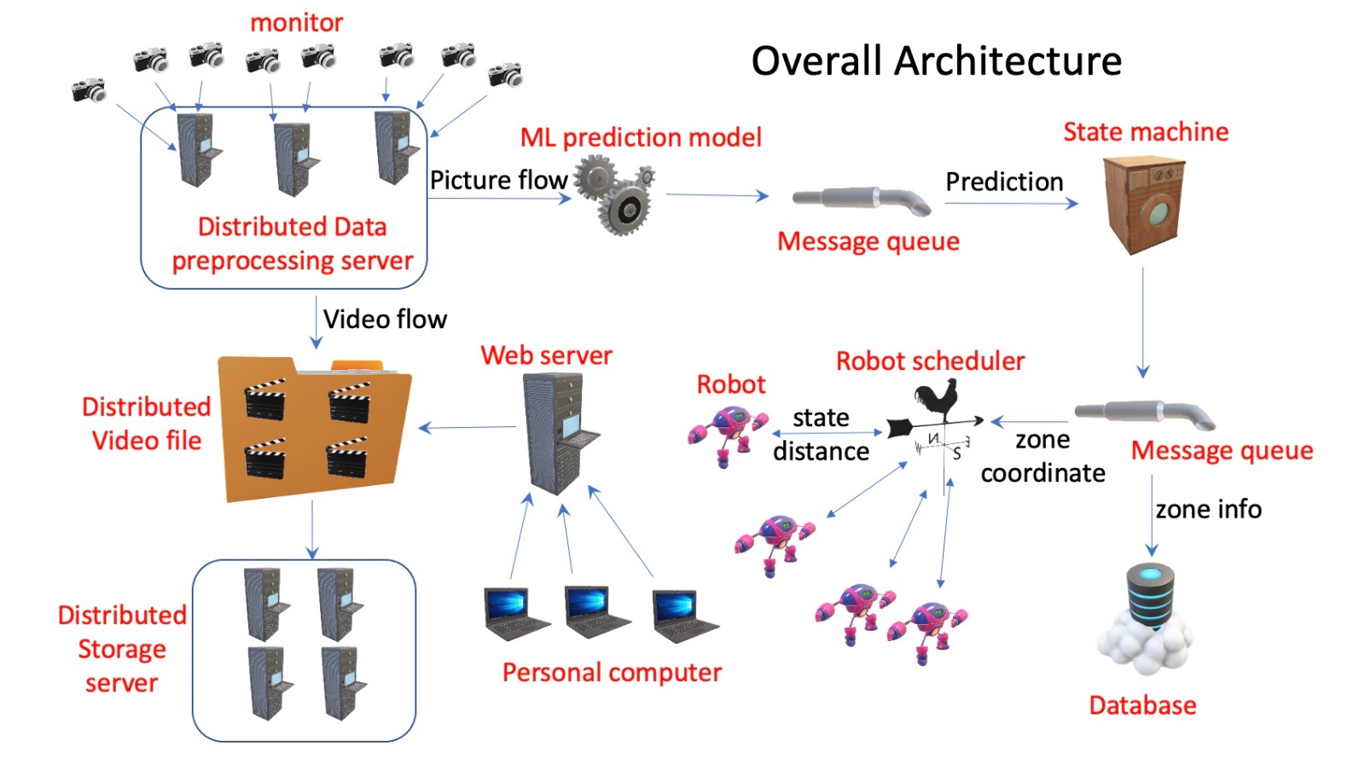

Slide 7
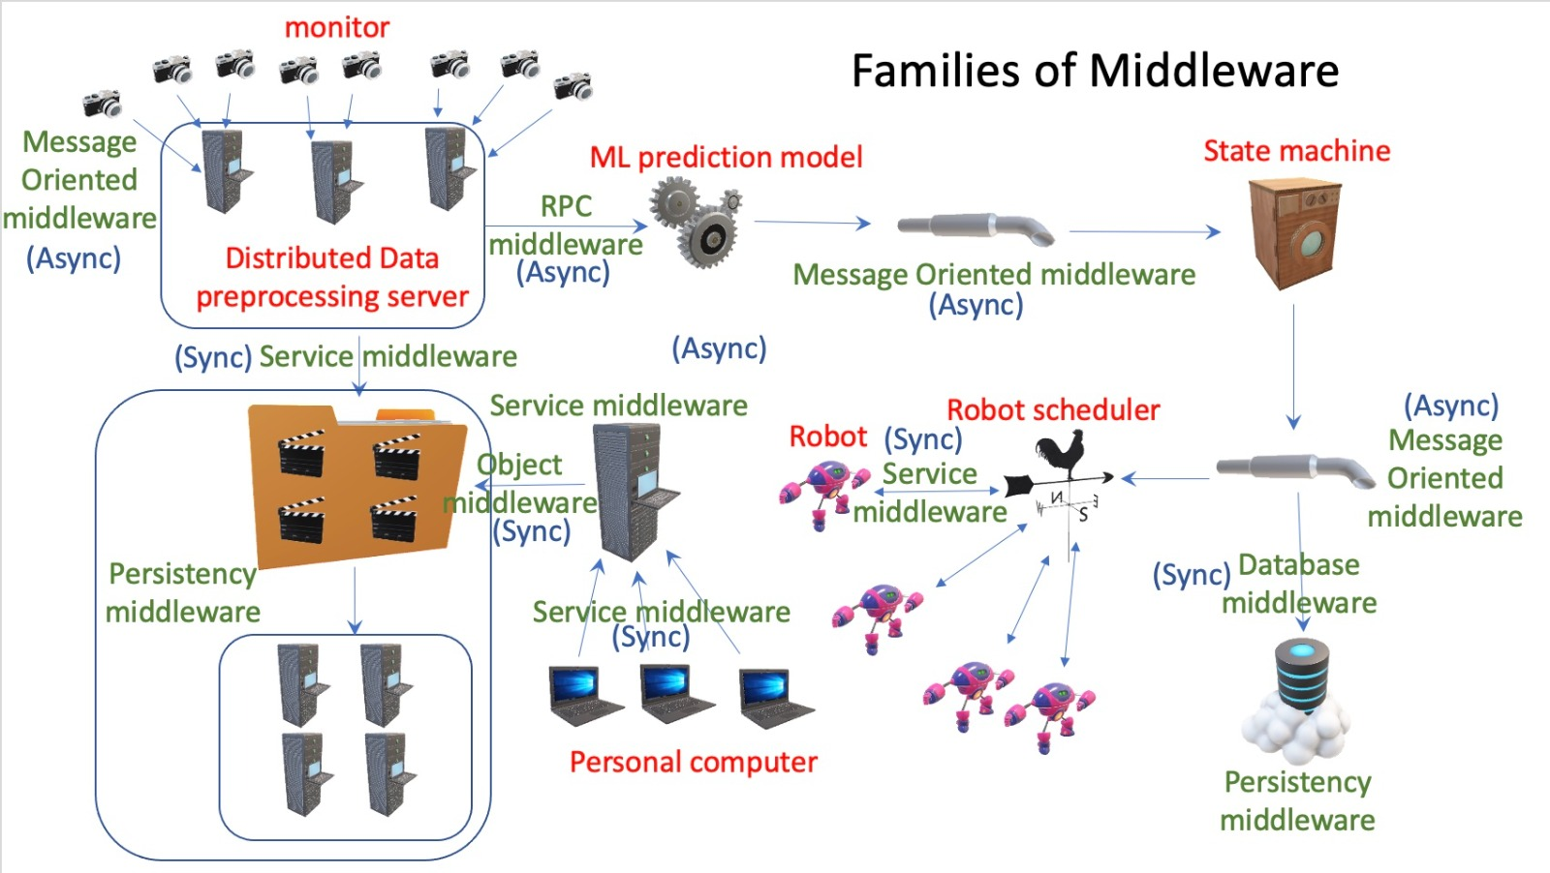

Slide 8
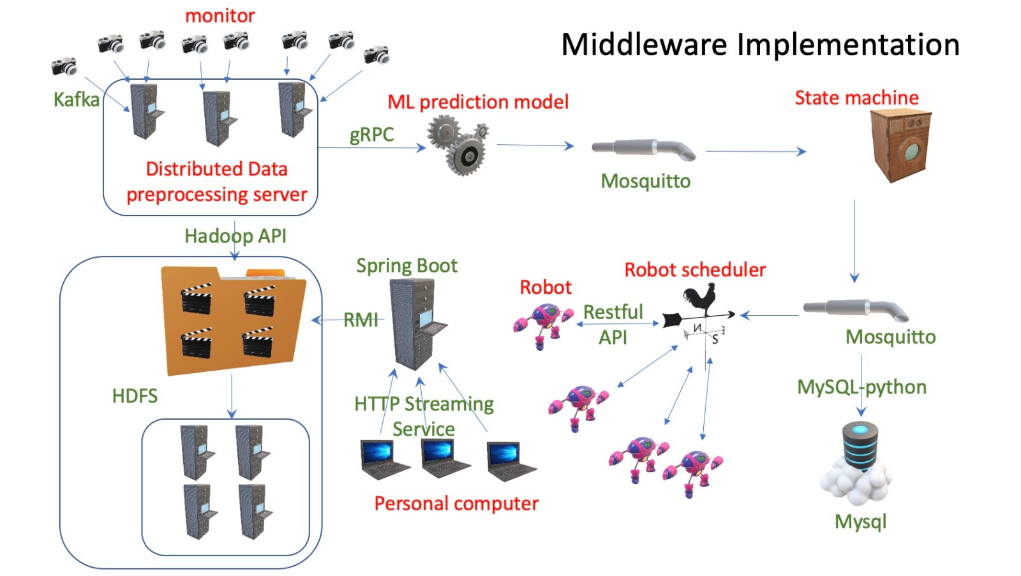

Slide 9
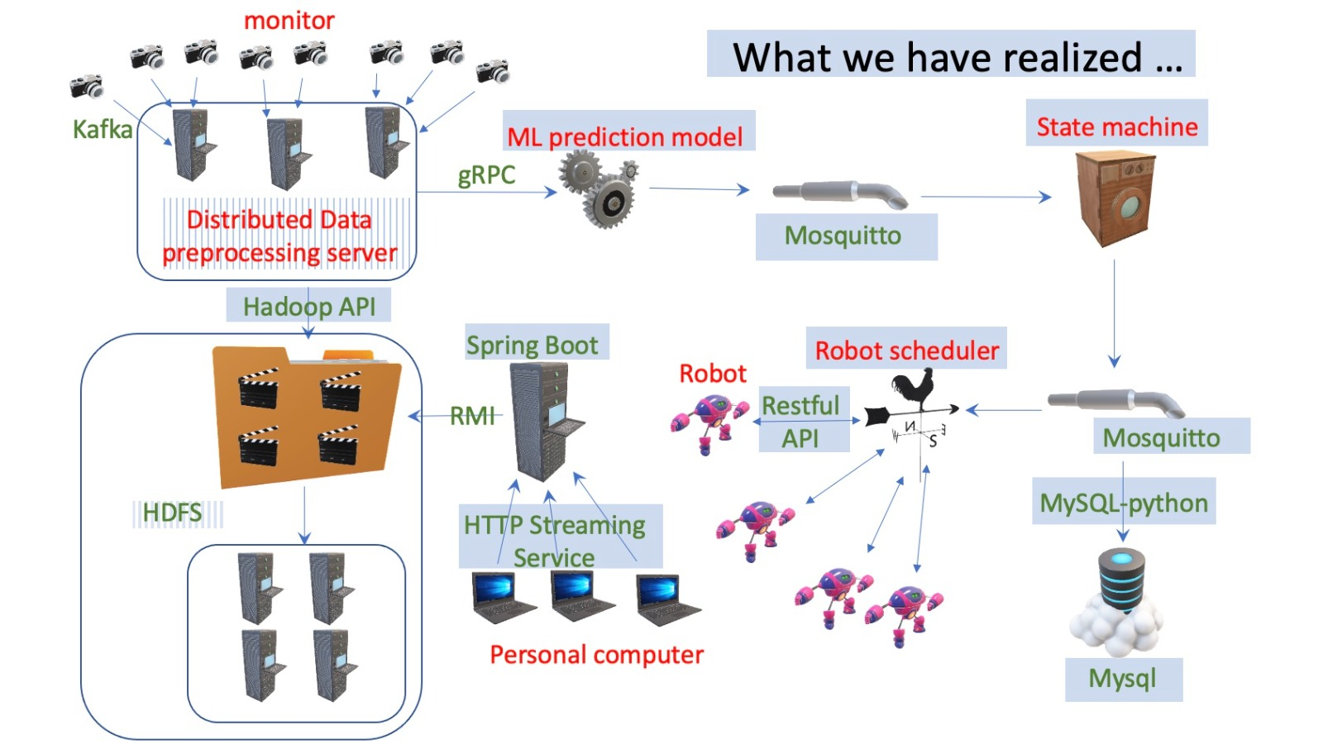

Slide 10
Conclusion and Future Work
Maybe implement distributed Pub/Sub for different zones in a city(only client zone subscribed to the topic can receive).
Cloud Integration: Scalability or data storage.
Send performance reports of the areas cleaned, the time taken, etc., all via the IOT sensors.
we can distribute the database in future making it more edge
Smart Navigation and Obstacle Avoidance
Transmit gps data using 5g

Slide 11
THANKS!
Any questions?
Github Repository: https://github.com/CharlieChee/smart_city_cleaning

